Slide 1
Image Classification
With CNN
G5 - Ahmad - Georg - Matheus - Sofia

Slide 2
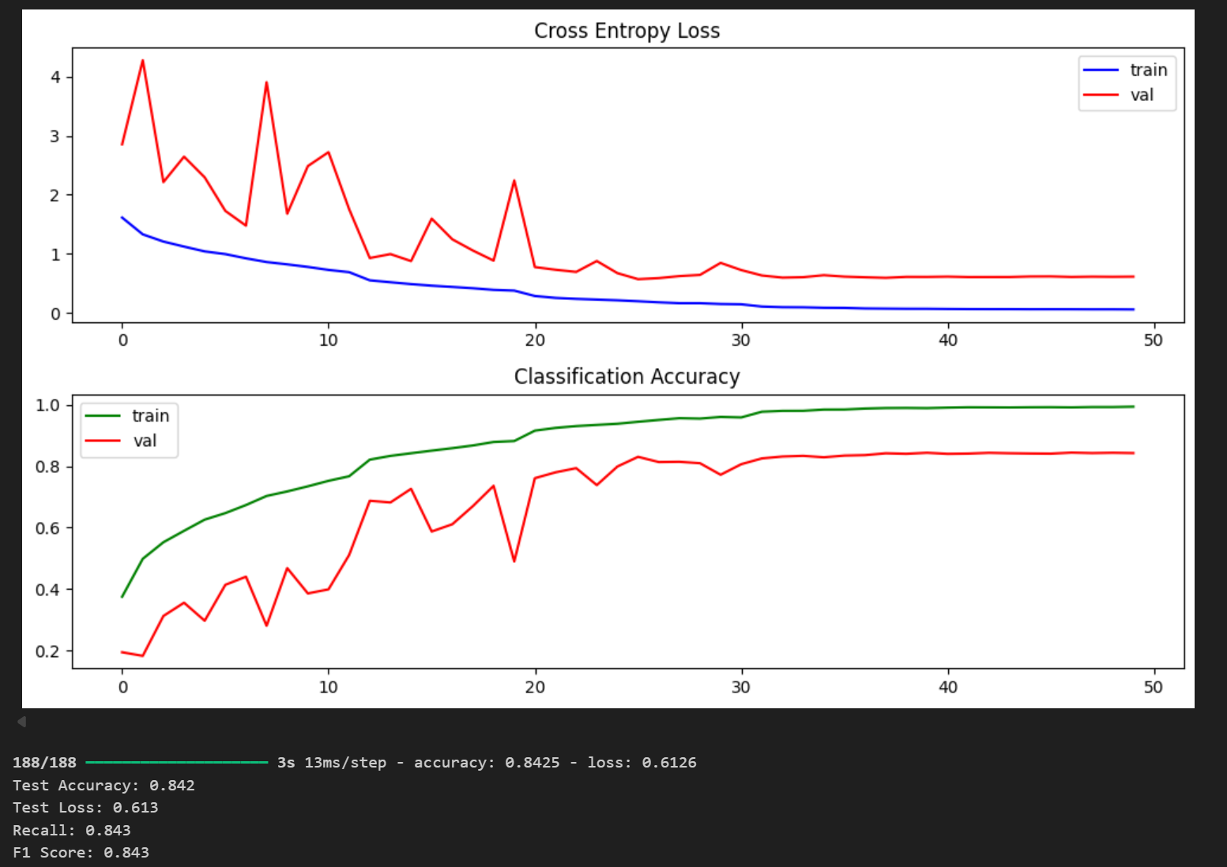
Executive summary
Accuracy: 0,8425
Loss: 0,6126
Best model: Resnet
F1 Score: 0,843
Recall: 0.843
Quick recap of alternatives: We also experimented with simple CNN | Data Augmentation | Transfer Learning
Other important considerations: Adding batch normalization in the simple CNN, we noticed that the acc and loss can get better, because for each epoch the model ran, we normalise it before running it.

Slide 3
Methods (preprocessing)
We used the CIFAR-10 dataset to train our models. We checked all the classes we had in the dataset, then we separated the classes into a vector on which we could train our models. We categorized in one-hot encoding the classes so the models could understand what we were working with.
One of the techniques we tried was to filter just the animal classes using binary filtering, and then remapping the indexes in a dictionary
Separating the data and training just with the animal classes it might generate some overfitting, but we didn’t noticed in our tests.

Slide 4
Image Classification with simple CNN
We set our Neural Network (NN), with 10 epochs, in a batch size of 64, the optimizer used for this experiment was Adam, with the activation of ReLU and Softmax, we used 4 layers of neurons to do it so.
We got a result in the training set of Acc.: 0.6849 and Loss: 8.905.
The validation set we got the results of: Acc.: 0.6835 and Loss: 9.255

Slide 5
Image Classification with Data Augmentation
We set our Neural Network (NN), with 50 epochs, in a batch size of 128, the optimizer used for this experiment was Adam, with the activation of ReLU and Softmax. We used 4 layers of neurons to do it.
With data augmentation, we noticed slightly better results; we could achieve the results in the training set of: Acc.: 0.7656 and Loss.: 0.7251 and in the Validation Set: Acc.: 0.6840 and Loss.: 0.9086

Slide 6
Image Classification with Resnet

Slide 8
Resnet Model
Explain the details of your model
Explain the results

Slide 9
Takeaways
Recap / conclusions
Challenges
Key learnings

